Slide 1
Automation Testing
Suresh Kumar Srinivasan
(Lead Product Efficiency Engineer)

Slide 2
Selenium
What is Selenium?
Selenium is one of the most widely used open source Web UI (User Interface) automation testing suite.
Selenium supports automation across different browsers, platforms and programming languages.
Following is the list:
Programming Languages: C#, Java, Python, PHP, Ruby, Perl, and JavaScript
Operating Systems: Windows, Linux, Mac, Solaris.
Browsers: Google Chrome, Mozilla Firefox, Internet Explorer, Edge, Opera, Safari, etc.

Slide 3
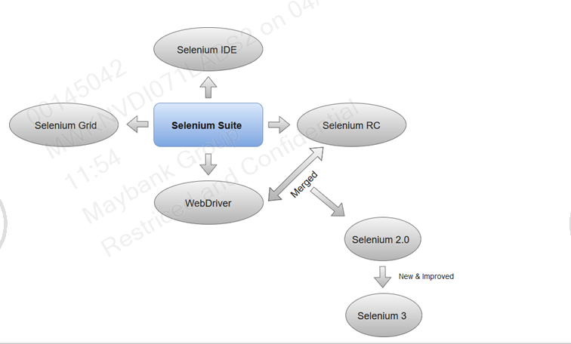
Selenium Suite :
Selenium Integrated Development Environment (IDE)
Selenium Remote Control (Now Deprecated)
Selenium WebDriver
Selenium Grid

Slide 4
Components:
Selenium IDE:
Selenium IDE is implemented as Firefox extension which provides record and playback functionality on test scripts. It allows testers to export recorded scripts in many languages like HTML, Java, Ruby, Python and C#.
Selenium RC:
Selenium RC (officially deprecated by selenium)allows testers to write automated web application UI test in any of the supported programming languages.
Selenium Web Driver:
Selenium web driver does not require server installation, test scripts interact directly with the browser.
Limitations:
Selenium does not support automation testing for desktop applications.
Selenium requires high skill sets in order to automate tests more effectively.
Since Selenium is open source software, you have to rely on community forums to get your technical issues resolved.

Slide 5
Locators
Types of locators:
Selenium Web Driver has 8 locators which helps us to locate the web elements on DOM
ID
Name
Class
Xpath
CssSelectors
LinkText
PartialLinkText
TagName

Slide 6
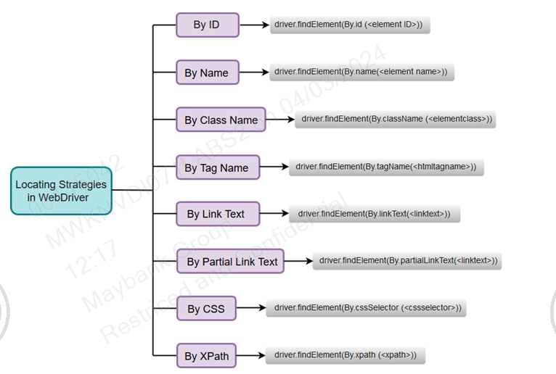
Type of Locators:

Slide 7
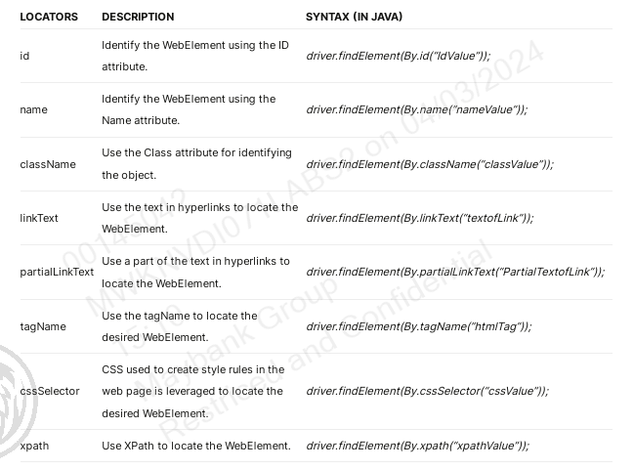
Type of Locators:

Slide 8
Xpaths
Xpath stands for XML Path Language. It uses a non-XML syntax to provide a flexible way of addressing (pointing to) different parts of an XML document. It can also be used to test addressed nodes within a document to determine whether they match a pattern or not.
Format:
“//tagname[@attr , ’value’]
Example:
"//h4[@id='SAP M']
Types of Xpaths:
Absolute XPath: Begins from the root of the HTML document and specifies the complete path to the element. It's not as flexible and can break if the page structure changes.
Example: The absolute xpath is “/html/body/div[1]/div/div[1]/a”
Relative XPath: Starts from a specific element and navigates through the DOM hierarchy to locate the desired element.
Example: A relative xpath starts with the “//”

Slide 9
Functions
Contains is a function used to search for the web elements that contain a particular text.
Example:
"//h4//a[contains(text(),'SAP M')]"
Starts-with and Ends-with are to find the elements whose attribute dynamically changes on refresh or other operations like click, submit, etc.
Example:
Xpath=//label[starts-with(@id,'message')]
Xpath=//label[ends-with(@id,'message')]
AND finds the element in case of both the conditions are true
Example:
Xpath=//input[@type='submit' AND @name='btnLogin']
OR finds the element in case of any one of the conditions is true
Example:
Xpath=//*[@type='submit' OR @name='btnReset']

Slide 10
Functions
Parent is a method used to retrieve the parent node of the current node selected in the web page.
Example:
Xpath=//*[@id='rt-feature']//parent::div
Following will return the immediate element of the particular component.
Example:
Xpath=//*[@type='text']//following::input
Following-Sibling is a function used to fetch a web element which is a sibling to the parent element
Example:
"//div[@class='canvas- graph']//a[@href='/accounting.html'][i[@class='icon-usd']]/following-sibling::h4“
Ancestor is to find an element on the basis of the parent element we can use ancestor attribute of XPath.
Example:
"//div[.//a[text()='SELENIUM']]/ancestor::div[@class='rt-grid-2 rt-omega']/following-sibling::div“
Preceding is the function will return the preceding element of the particular element.
Example:
Xpath= //*[@type='submit']//preceding::input

Slide 11
Waits
Selenium Waits are commands that help wait for a certain condition to happen before proceeding further in the code.
Implicit Wait:
The WebDriver directs the Selenium WebDriver to wait for a certain measure of time before throwing an exception. Once this time is set, WebDriver will wait for the element before the exception occurs.
Syntax:
driver.manage().timeouts().implicitlyWait(10, TimeUnit.SECONDS);
Explicit Wait:
The WebDriver is directed to wait until a certain condition occurs before proceeding with executing the code.
Syntax:
wait.until(ExpectedConditions.visibilityOfElementLocated(By.xpath(‘//tagname[@attr=‘’value’]

Slide 12
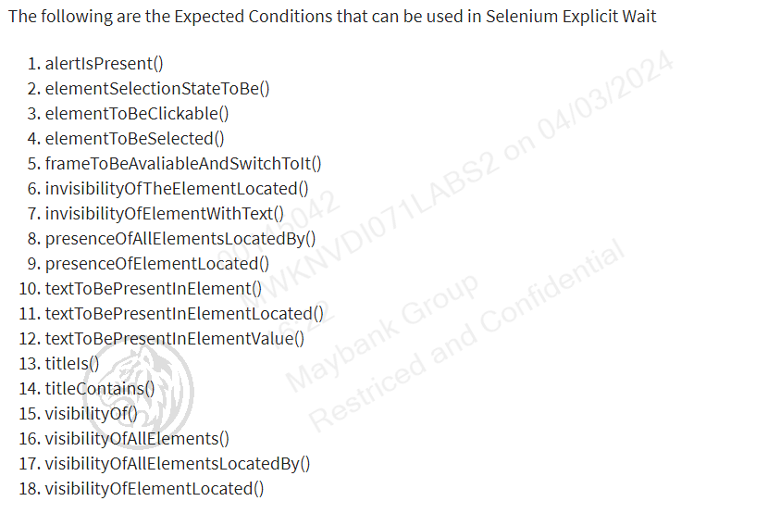
Waits

Slide 13
Windows
Window:
Sometimes when we click on a particular web element it opens a new window. To locate the web elements on the new window webpage, we need to shift the focus of selenium from the current page (parent window) to the new page (child window).
Syntax:
driver.switchTo().window(ID);
driver.switchTo().window(name);
driver.switchTo().window(index);
ID/Name,Index of a particular window on which you need the change the focus of selenium.
To get the ID of Windows we will use the following method.
driver.getWindowHandle(): To get the ID of the parent window (main window)
driver.getWindowHandles(): To get the ID of child windows (new window)

Slide 14
Frames
Frames in Selenium are segments of an HTML document, also known as iframes, that contain individual HTML documents, frequently used when a webpage has several sections or pages that must be displayed or interacted with independently.
Syntax:
driver.switchTo().frame(ID);
driver.switchTo().frame(name);
driver.switchTo().frame(index);

Slide 15
Close and Quit
Close:
To close the current window or tab.
Driver.close();
Quit:
Close all the windows and tabs associated with that WebDriver session
Close the browser process
Close the background driver process
Driver.quit();

Slide 16
Questions ???

Slide 17
THANK YOU

